Slide 1
Instructions
Setting Up & Accessing StudySync
Aguirre
Notes:
Description: This is a title slide.

Slide 2
Setting Up & Accessing StudySync
Completing StudySync Assignments
Example StudySync Assignment Responses

Slide 3
Setting Up StudySync
(Complete ONCE ONLY)

Slide 4



Access StudySync from Clever
Sign in to Clever;
Locate and click on the McGrawHill Education (ConnectEd) icon; and
Launch California StudySync ELA with ELD. This involves clicking multiple links in a row. Pretend the orange circle in the StudySync logo is a button, and just keep clicking that option until you see the StudySync dashboard.
Video Link
Notes:
Description: This is an announcement slide.

Slide 5
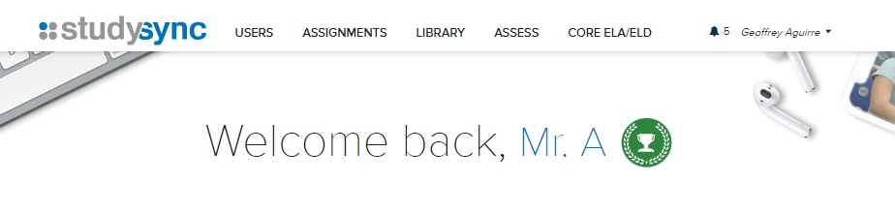
Access StudySync from Clever
You will know you are at the dashboard when you see your name in the upper-right-hand corner and a greeting in the center part of the screen.
Notes:
Description: This is an announcement slide.

Slide 6

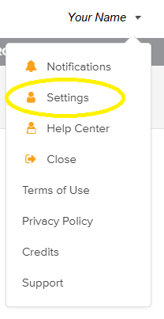
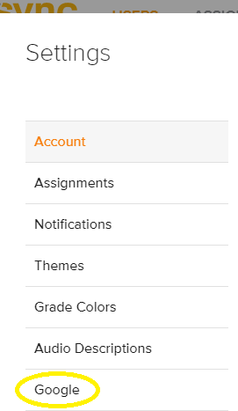
Setting up StudySync
Once you are logged in to StudySync:
Locate your name in the upper right-hand corner;
Click on the downward-pointing arrow;
Select “Settings”;
Select “Google” at the bottom of the list; and
Sign in to Google and enable Google integrations.
Notes:
Description: This is an announcement slide.

Slide 7
You will now be able to access studysync assignments by clicking on Assignments in Google Classroom.
Points earned in StudySync (such as through quizzes) will now sync with Google Classroom, which means you will receive credit.

Slide 8
Accessing StudySync
(After Initial Setup)
Notes:
Description: This is a subsection title slide.

Slide 9
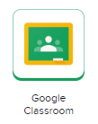
Access Google Classroom from Clever
Sign in to Clever;
Locate and click on the Google Classroom icon.
Notes:
Description: This is an announcement slide.

Slide 10



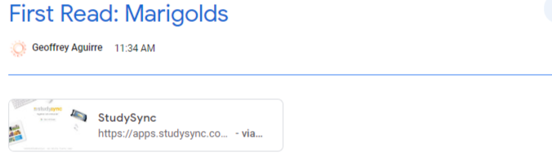
Access StudySync Assignments
Through Google Classroom
Once you are logged in to Google Classroom:
Locate and click on the “classwork” tab on the upper part of the screen;
Locate and click on the desired day in the left-hand menu;
Click on the assignment name; and
Click on the StudySync link; or
Click on “view assignment” and then click on the StudySync link.
Notes:
Description: This is an announcement slide.

Slide 11
Provided you correctly set up StudySync, links will take you directly to the assignment.

